Slide 1
Project 1
By Kory Iwahashi

Slide 2
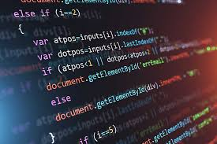
Table of Contents
1. Challenge and Requirements
2. SDLC
3. Kanban Board
4. Building the Salesforce App

Slide 3
Challenge
Salesforce App for a Business

Slide 4
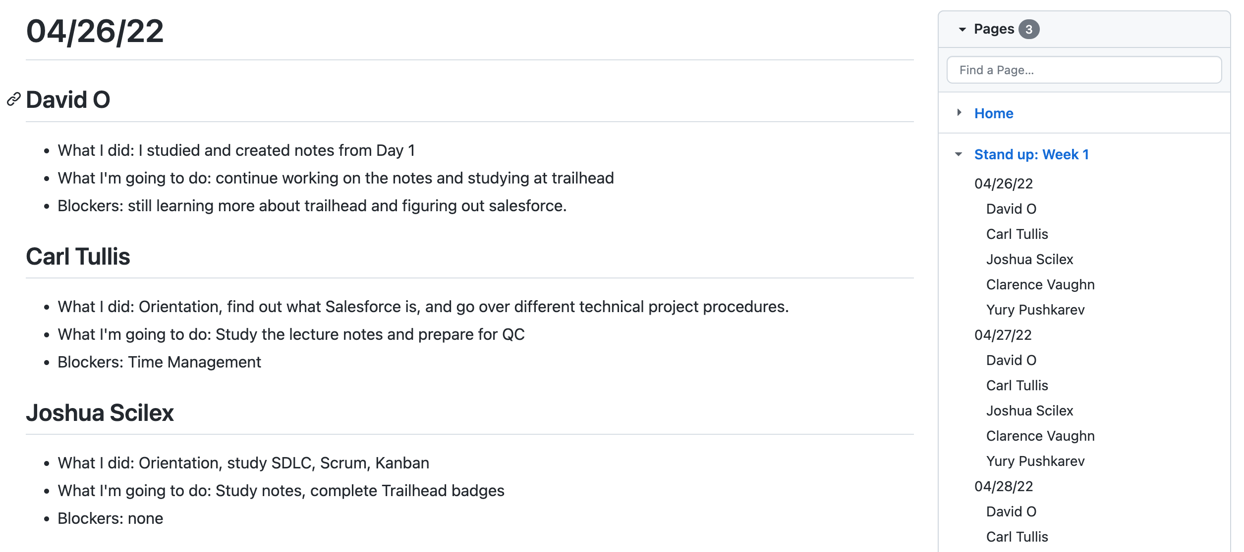
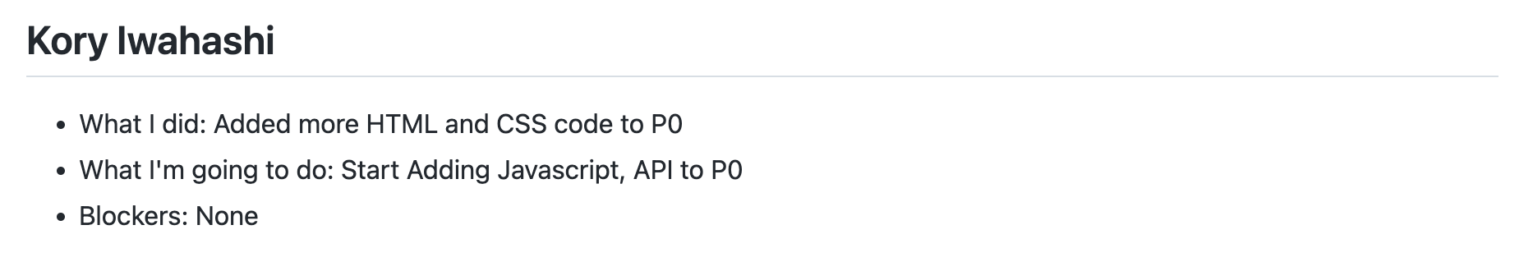
SDLC & Scrumban
Notes:
Talk about what SDLC is (simplify to the 3 phases), what framework I used. Standup Notes

Slide 5
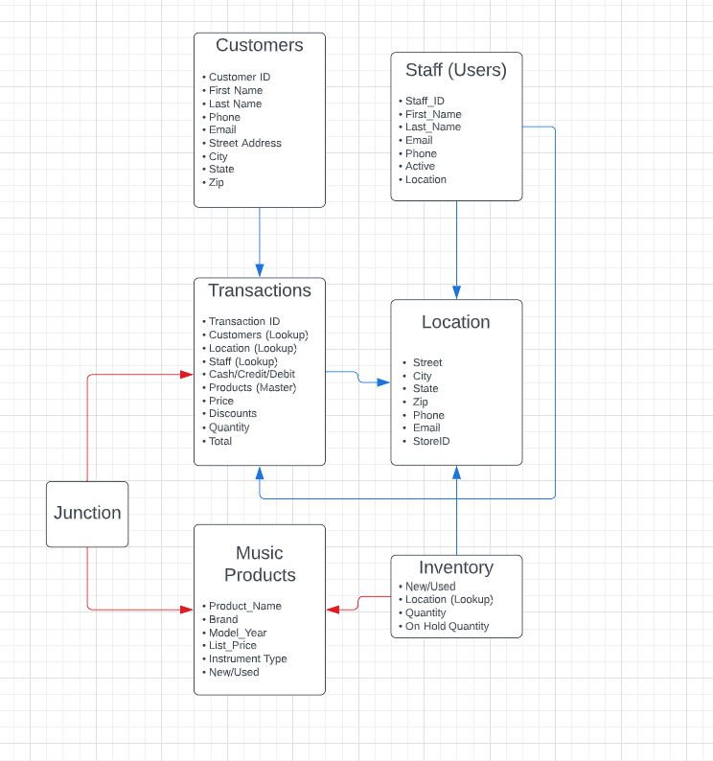
ERD
Data Model Rough Draft
Notes:
The design process, priority in terms of requirements

Slide 6
Questions?

